Slide 1



Autism Classification Using Support Vector Machine Model and the AQ-10 Survey
KJ MoChroi
Department of Data Science, Bellevue University
DSC 680: Applied Data Science
Dr. Brett Werner
April 9th, 2023
Notes:
My name is Karlie Schwartzwald and for this project I will be using data collected from a ten-question survey called the Autism Quotient - 10 Questions (AQ-10) to create a binary support vector machine (SVM) classification model that can determine whether an adult should be referred to a professional clinician for the possible diagnosis of autism spectrum disorder. This investigation can be used to determine whether this short questionnaire is adequate in identifying such adults or whether a more thorough approach is needed.

Slide 2
What is autism?
A loosely defined cluster of neurodevelopmental disorders characterized by challenges in:
social interaction
verbal and nonverbal communication
and often repetitive behaviors and restricted interests.
Can be diagnosed during childhood, adolescence, and adulthood.
(Autism spectrum, 2023)
Notes:
The autism spectrum, also known as autism spectrum disorder (ASD) or autism spectrum condition (ASC), is a “loosely defined cluster of neurodevelopmental disorders characterized by challenges in social interaction, verbal and nonverbal communication, and often repetitive behaviors and restricted interests.” (Autism spectrum, 2023) Autism is a lifelong condition and can be diagnosed during childhood, adolescence, and adulthood.

Slide 3
For Adults, diagnosis is much harder to get than it is for children because:
Lack of trained specialists
Financial burden, as diagnosis is not covered by insurance
They may not have the knowledge or resources to realize they should be tested
Notes:
However, diagnosis for adults is much more difficult to obtain for several reasons. First, there are fewer clinicians who specialize in adult diagnosis so the wait times can be very lengthy, or a clinician might not be in your geographical area. Second, the financial burden can be a huge obstacle for autistic adults as diagnosis often exceed $5,000 and is typically not covered by insurance in the United States. Third, adults who have gone undiagnosed their entire life may not realize that they could even be autistic.

Slide 4

What is the AQ-10 and Why Do We Need Self-questionnaires?
The Autism Quotient – 10 Questions (AQ-10) is a shortened, simplified self-report questionnaire that aims to identify adults with autism.
“Autism is difficult to identify in adults due to lack of validated self‐report questionnaires.” (Brugha et al., 2020)
“These tests correctly identified autism spectrum disorder patients in almost 80% of the referred cases.” (Sizoo et al., 2015)
Notes:
Furthermore, “autism [in adults] is difficult to identify in adults due to lack of validated self‐report questionnaires.” (Brugha et al., 2020) The use of self-questionnaires has been well researched in this discipline and an analysis of some of the current questionnaires used in identifying adult autism showed that “these tests correctly identified autism spectrum disorder patients in almost 80% of the referred cases.” (Sizoo et al., 2015) The AQ-10 aims to increase access for adults by creating a very short self-administered questionnaire that can identify possibly autistic adults who should seek further testing.

Slide 5
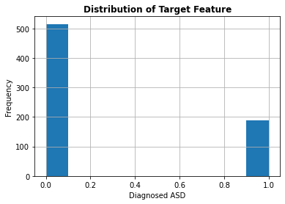
Our data
21 features
10 demographic features
10 answer features
1 binary target feature
Only the 10 answer features were used in training the model
Notes:
The data consists of 21 variables including some demographic information, the responses to 10 questions, and the binary target feature. The demographic features consist of age, age description, gender (binary), country of residence, and the relation of the person filling out the form to the person being referenced on the survey. The demographic information was used during the exploratory analysis to better understand which populations may be underrepresented in the study.
However, when it came time to train the model the demographic features were dropped and only the 10 response features were included in the training. These demographic features were the only training features to contain missing information so when they were dropped, we simultaneously cleaned the dataset if missing values. The target feature is a binary categorical variable that has just over 500 instances of non-ASD (identified with the binary value 0) and just under 200 of ASD (identified with the binary value 1) as shown in Figure 1.

Slide 6


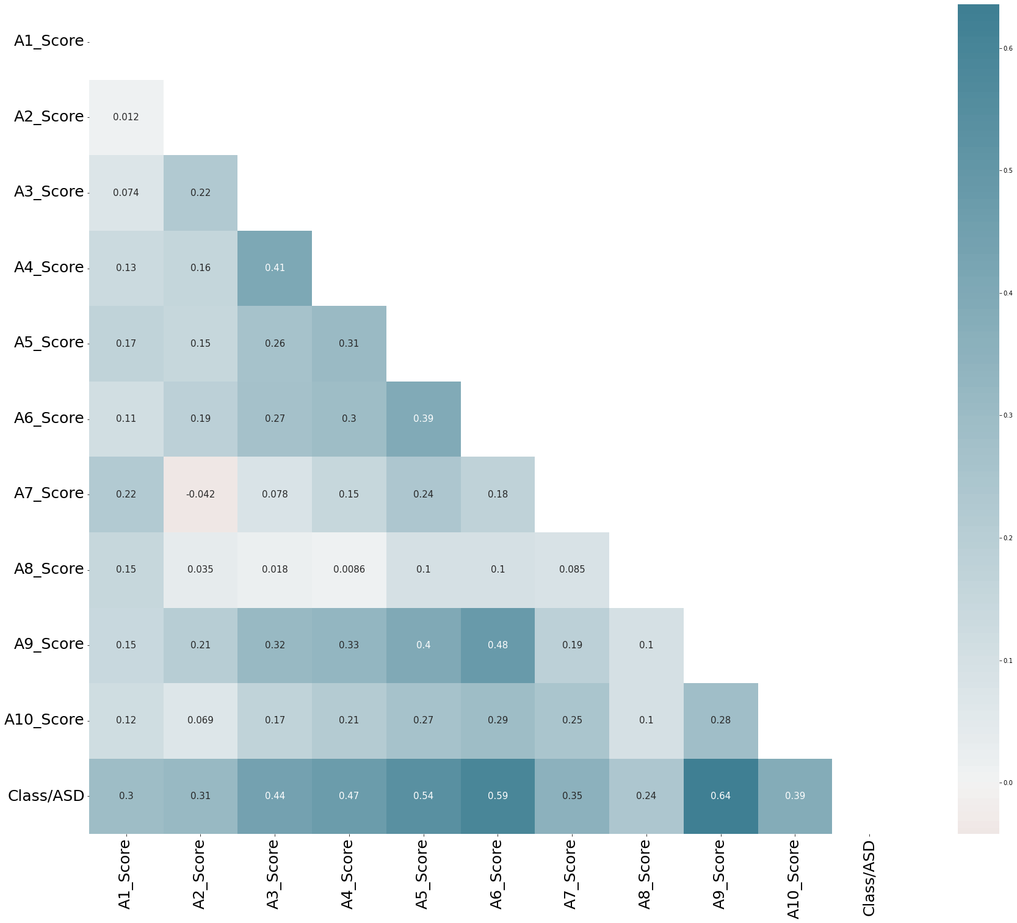
Correlation
Notes:
Since all the training features were integer values, and the target feature was a binary categorical variable, I decided to use Pearson’s correlation coefficient to estimate the predictive strength of the training features. I found that all the training features had some predictive power with Pearson’s correlation scores between 0.24 and 0.64 as can be seen in the correlation heat map.

Slide 7

The Model
SVM classifier
Hyperparameter Tuning
C=10
Gamma = 0.1
Kernel = RBF
SVM classifier
Hyperparameter Tuning
C=10
Gamma = 0.1
Kernel = RBF
Notes:
The data was split into a training set which consisted of 70% of the data and a testing dataset which contained the other 30%. It was unnecessary to scale the data, as all the responses consisted of an identical range of integer outcomes. For the SVM model I did hyperparameter tuning on the hyperparameters of C, gamma, and kernel to find the best parameters to optimize the accuracy of the model.
Hyperparameter tuning yielded the best parameters for this model to be C=10, gamma=0.1, and an RBF kernel. I used cross-fold validation to evaluate the accuracy of the model.

Slide 8
The Results
We used cross-fold validation to measure accuracy
With 5 folds, accuracy averages to 99.4%
This is very high, especially when compared to the null model
Null model which chooses not-autistic for every instance has an accuracy of approximately 70%.
Notes:
After hyperparameter tuning, the model averaged an accuracy of 99.4% when split over 5 folds. We can compare the accuracy to that of a null model where we simply predict the most common category for each instance. This model a very high accuracy, especially when compared to the accuracy of the null model accuracy which would be approximately 70%.
In conclusion, the accuracy of the model is very high, and we can consider this model a success. This model may even be accurate enough to deploy in the field to help adults decide if their situation warrants further investigation from medical professionals. Since autism is not a life-threatening condition, the small number of errors that this model makes should not be catastrophic for an individual who uses this model.

Slide 9
Assumptions and Limitations
Adults (age 16+) with suspected autism who do not have a learning disability
Correct labeling of target feature
Getting a diagnosis is beneficial to autistic adults
Notes:
There are some assumptions to address when discussing this model. First and foremost, it should be noted that this test was designed for adults (age 16+) with suspected autism who do not have a learning disability. Thus, we must assume people taking this survey fall within those parameters. Furthermore, this model relies upon the previous diagnosis of individuals taking the survey. We must assume that those individuals labeled ASD are correctly diagnosed and we must also assume that those labeled as non-ASD are not undiagnosed autistics themselves. Given the large number of undiagnosed autistic adults this assumption may not be valid. Our final assumption is that it is beneficial for adults to learn they are autistic and therefore beneficial to provide resources for those who may seek diagnosis, such as surveys like the AQ-10.
These sorts of questionnaires rely on the ability of the individual to reflect on their own behavior and experiences and to contextualize those experiences within the framework of what is ‘normal.’ For example, the survey asks the individual to make comparisons between their own behavior and the behavior they see in others around them. This can be challenging for autistic individuals and thus is a limitation of this survey.

Slide 10
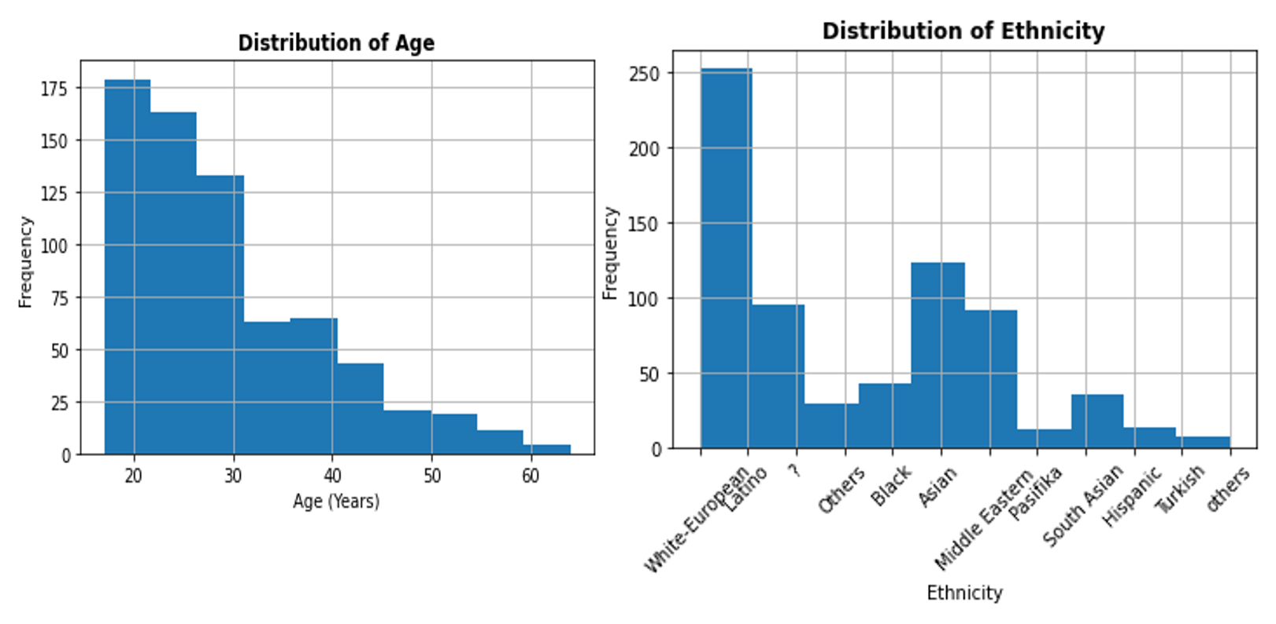
Ethical Considerations
Notes:
There is a large ethical issue in this study regarding the number and type of respondents that are in this dataset. As can be seen in Figure 3, this dataset consists primarily of white and young individuals, which can lead to underrepresentation in the data for people of color as well as the elderly. Furthermore, young, white, wealthy people are already more likely to be diagnosed with ASD because of cultural biases in the medical community that put people of color and poor people at higher risk of misdiagnosis. The fact that this study overrepresents white and young individuals may exacerbate these biases in practice.

Slide 11
Implementation and Future Uses
SVM classifier
Hyperparameter Tuning
C=10
Gamma = 0.1
Kernel = RBF
Improving the AQ-10
Applying the model to other surveys
Notes:
In the future I would like to see an SVM model trained on other autism questionnaires such as the Autism Quotient (AQ), the Camouflaging Autistic Traits Quiz (CAT-Q) and the Ritvo Autism Asperger Diagnostic Scale–Revised (RAADS–R) which all vary in their approach to detecting autism in adults. I think this model could also be used to improve the AQ-10 and its current implementation. For example, the questions on the survey with the lowest predictive power may be replaced by questions that do have more predictive power. Also, currently, the AQ-10 is measuring the sum of the scores of each question and comparing the total to a benchmark. This weights the importance of each question equally, which we can see from the correlation heat map, is not appropriate.
Regarding the implementation of this model, I think it would be best suited as a replacement to the self-scoring questionnaires available online for people who are questioning whether they may be autistic. This should not replace the clinical assessment by a professional, but rather serve as an indicator of whether an individual should seek further testing. The current method for scoring this questionnaire has a lower accuracy than the SVM model created here so replacing the self-scoring method with the SVM model would create a more trustworthy approach to self-assessment online.

Slide 12
References
Brugha, T., Tyrer, F., Leaver, A., Lewis, S., Seaton, S., Morgan, Z., Tromans, S., & Rensburg, K. (2020). Testing adults by questionnaire for social and communication disorders, including autism spectrum disorders, in an adult mental health service population. International Journal of Methods in Psychiatric Research, 29(1). https://doi.org/10.1002/mpr.1814
Sizoo, B. B., Horwitz, E. H., Teunisse, J. P., Kan, C. C., Vissers, C. T. W. M., Forceville, E. J. M., Van Voorst, A. J. P., & Geurts, H. M. (2015). Predictive validity of self-report questionnaires in the assessment of Autism Spectrum Disorders in adults. Autism, 19(7), 842–849. https://doi.org/10.1177/1362361315589869
Wikimedia Foundation. (2023, April 6). Autism spectrum. Wikipedia. Retrieved April 7, 2023, from https://en.wikipedia.org/wiki/Autism_spectrum

